Slide 1
T40
Solar Power Generation
Course project
Intermediate presentation
Gustav Nikopensius
Lauri Lopp
Martin Leissoo
Notes:
We ARE GML, and we chose the kaggle “competition solar power generation data” as our course project

Slide 2
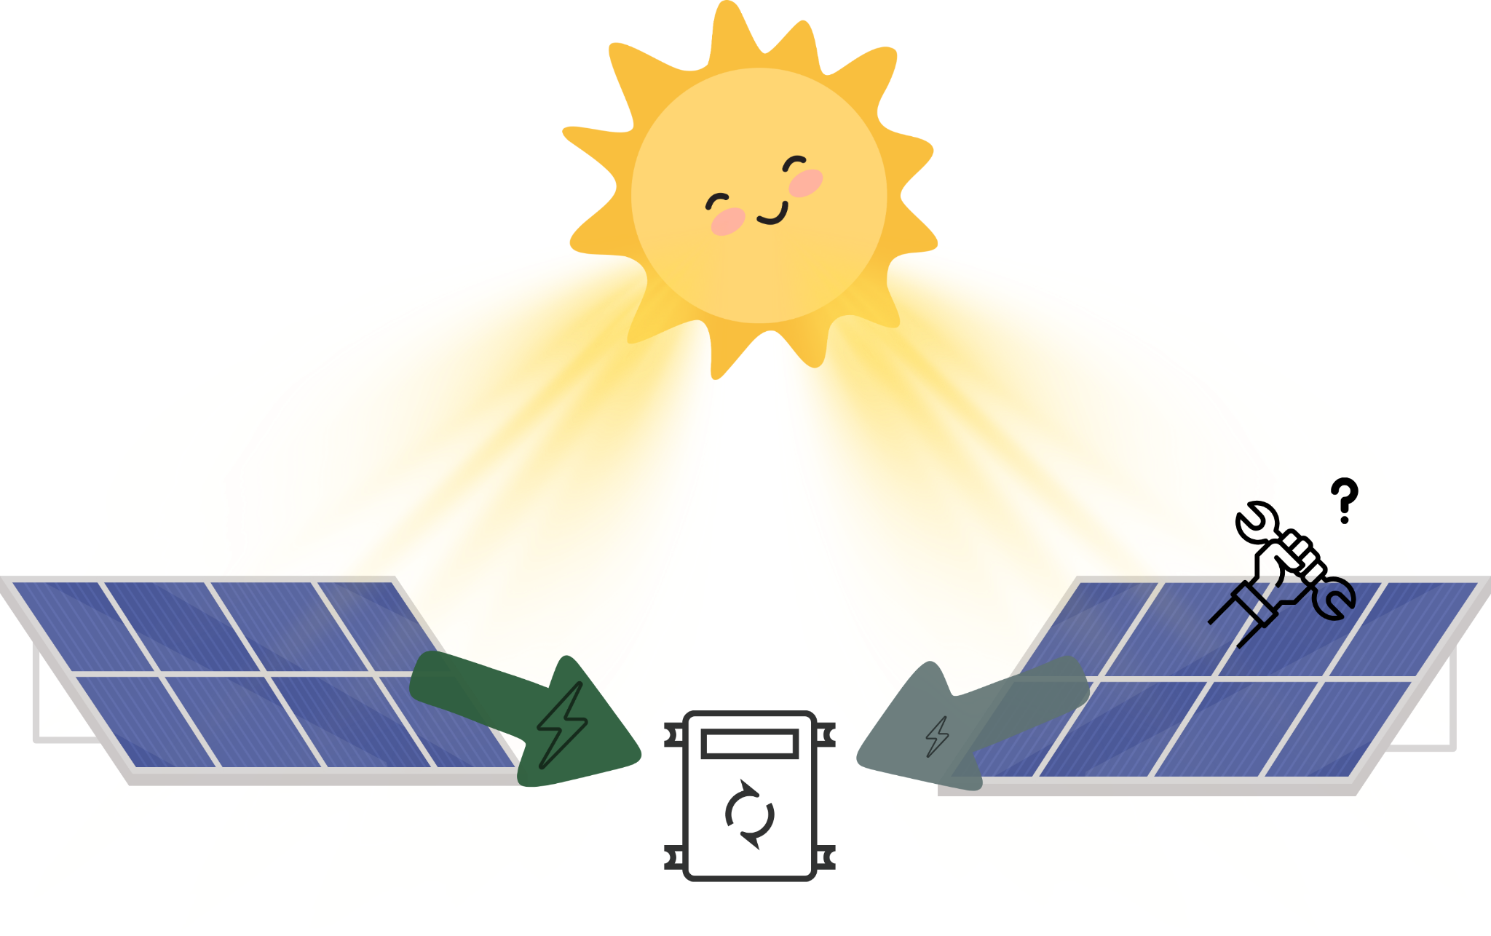
Three tasks
Understand and process data
Classify faulty equipment
Predict power production
Notes:
Basically we have two solar plants in india, consisting of many solar panels, which get hit by photons from the sun (IRRADIATION) and convert that energy to electricity, or DC current. Our challenge is to understand the data from these two plants and see if we can identify faulty suboptimal equipment

Slide 3
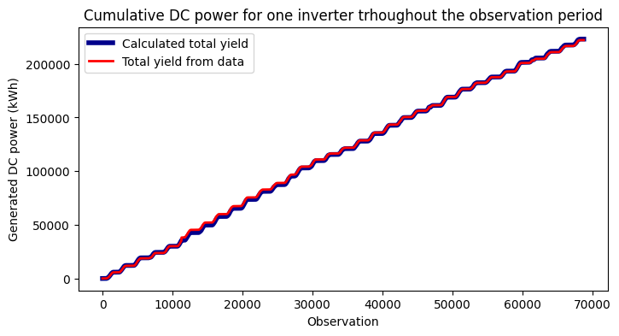
Understanding the data

Slide 4
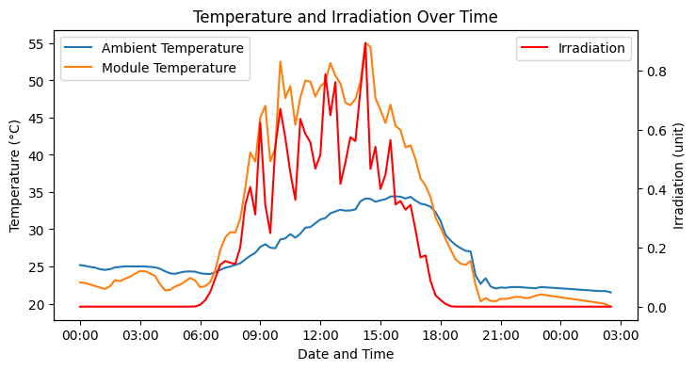
Understanding the data

Slide 5
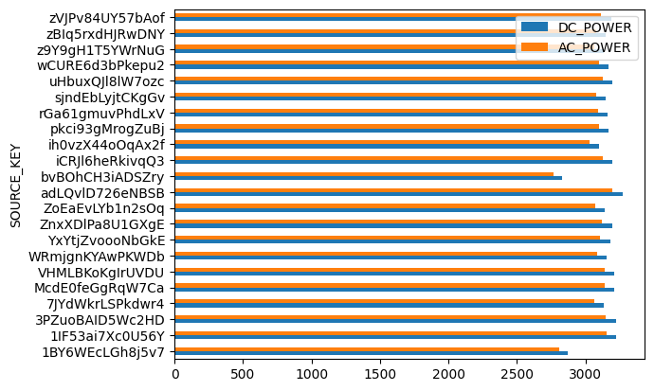
Understanding the data

Slide 6
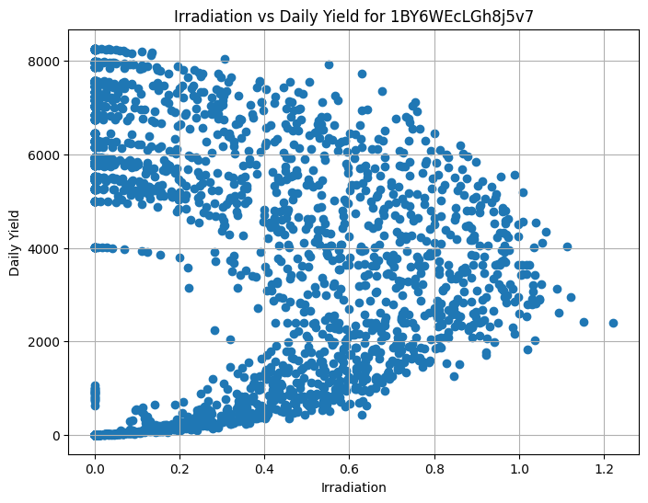
Understanding the data

Slide 7
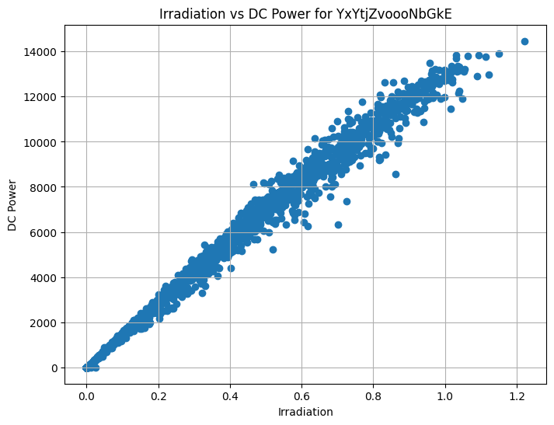
Power and Radiation

Slide 8
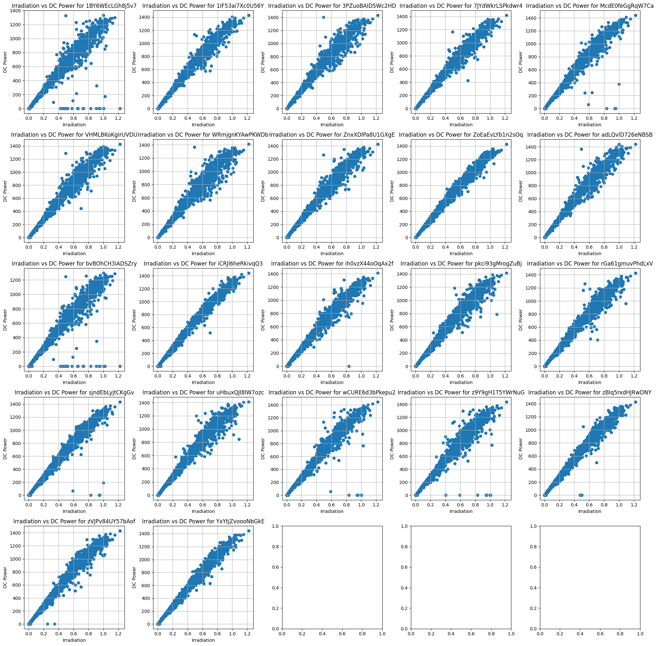
Plant 1

Slide 9
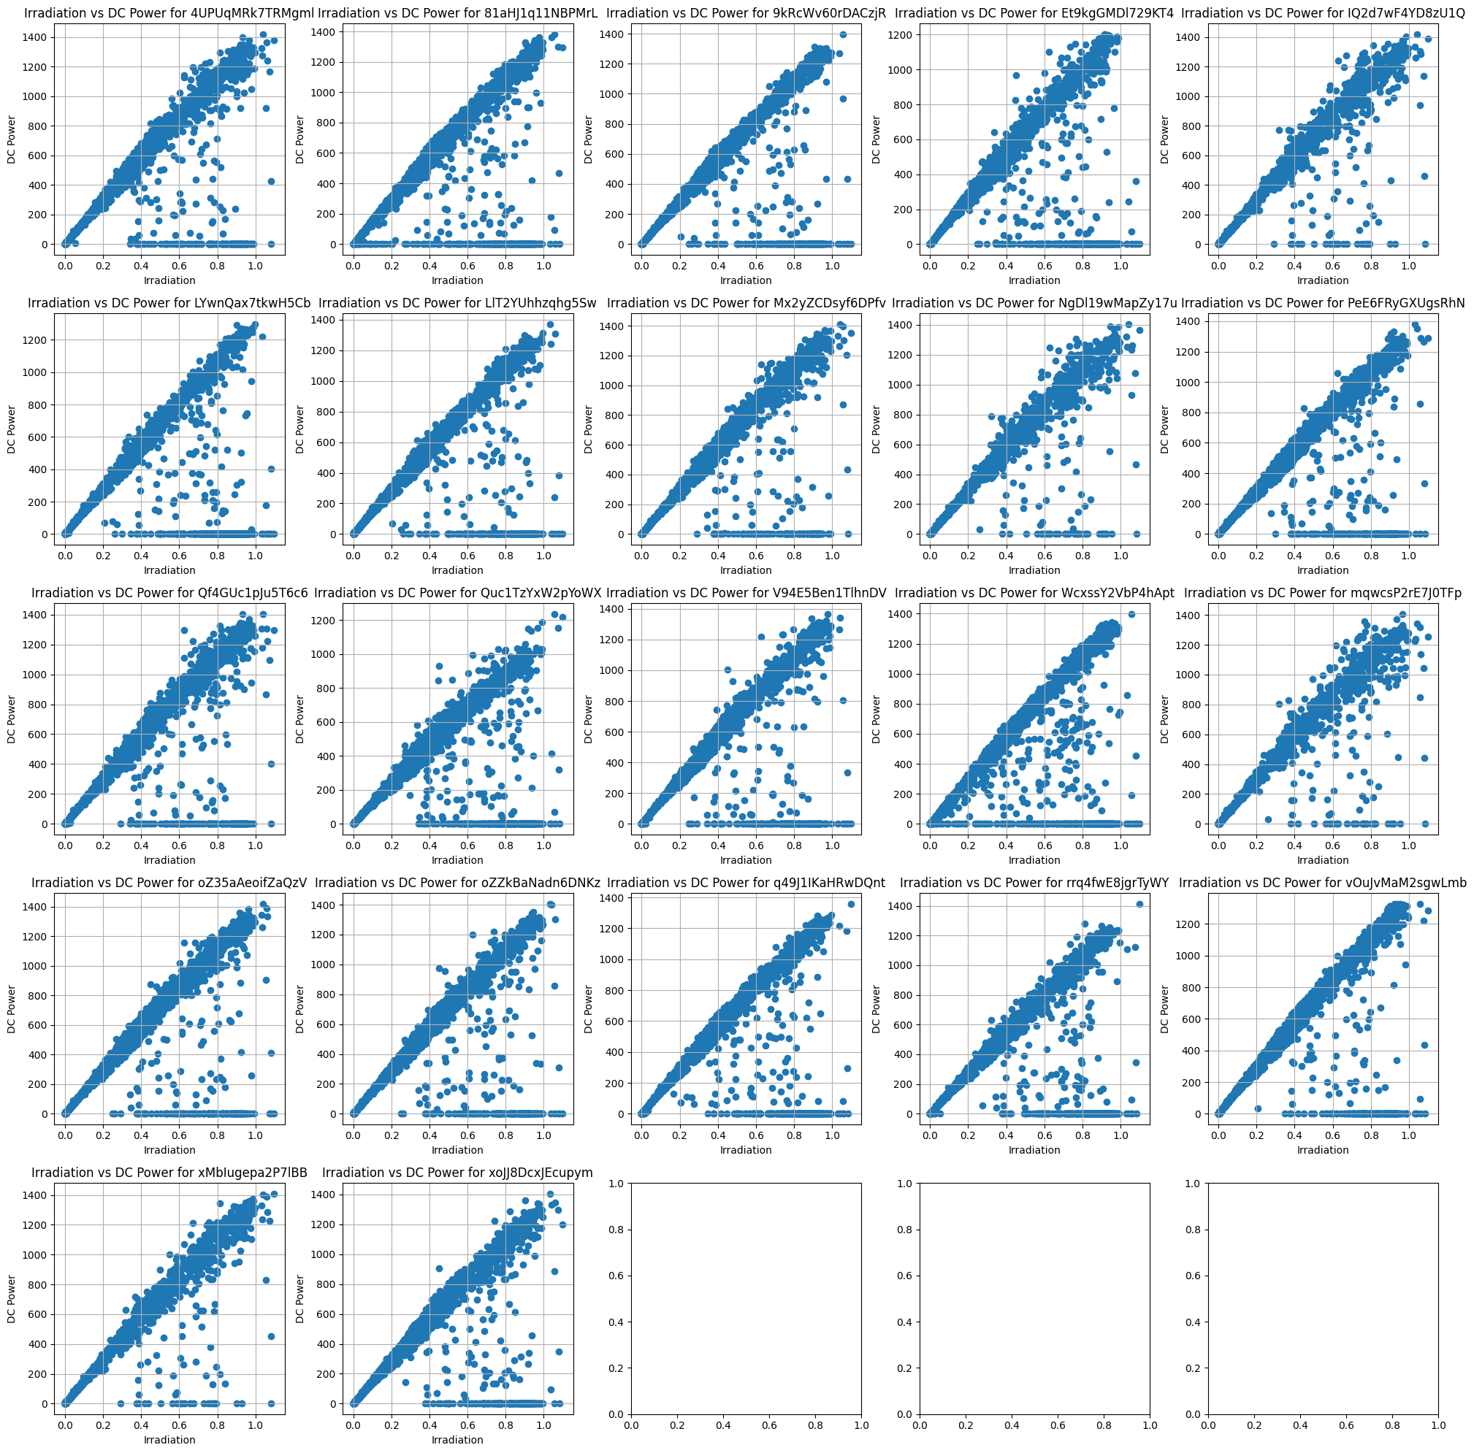
Plant 2

Slide 10
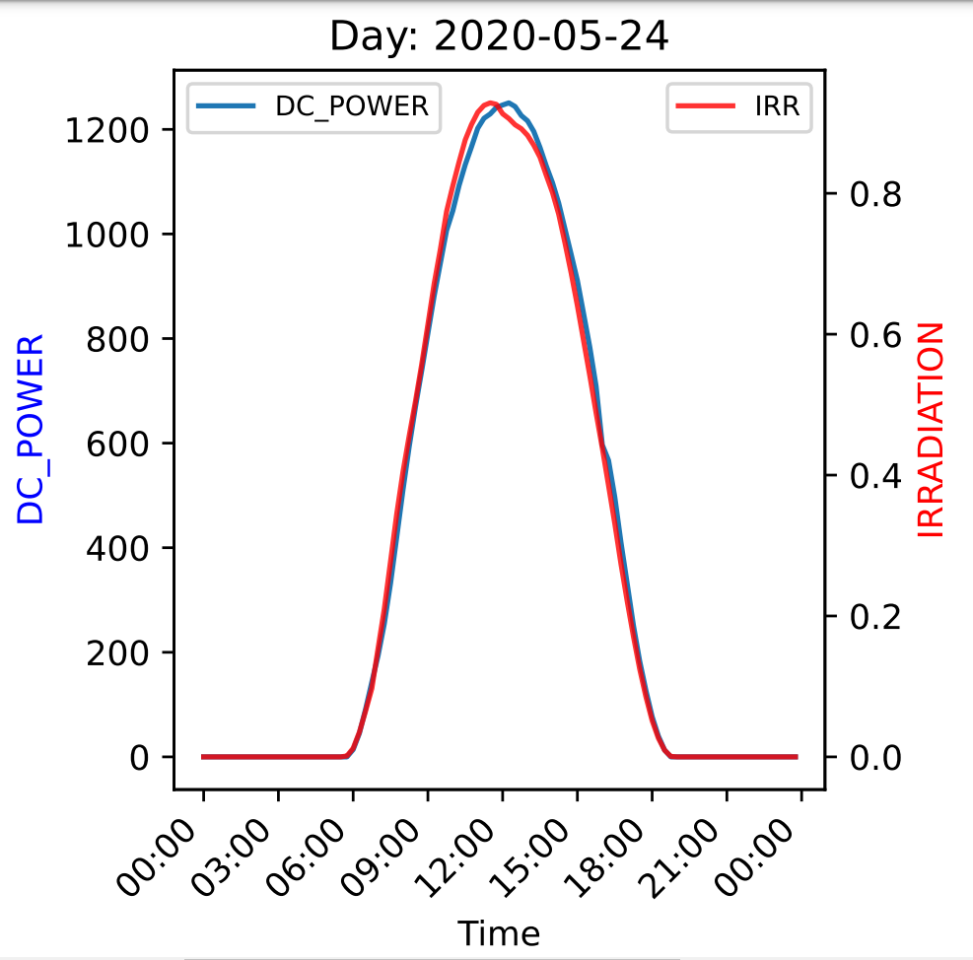
Power and Radiation on a timeline
Single inverter production in one day

Slide 11
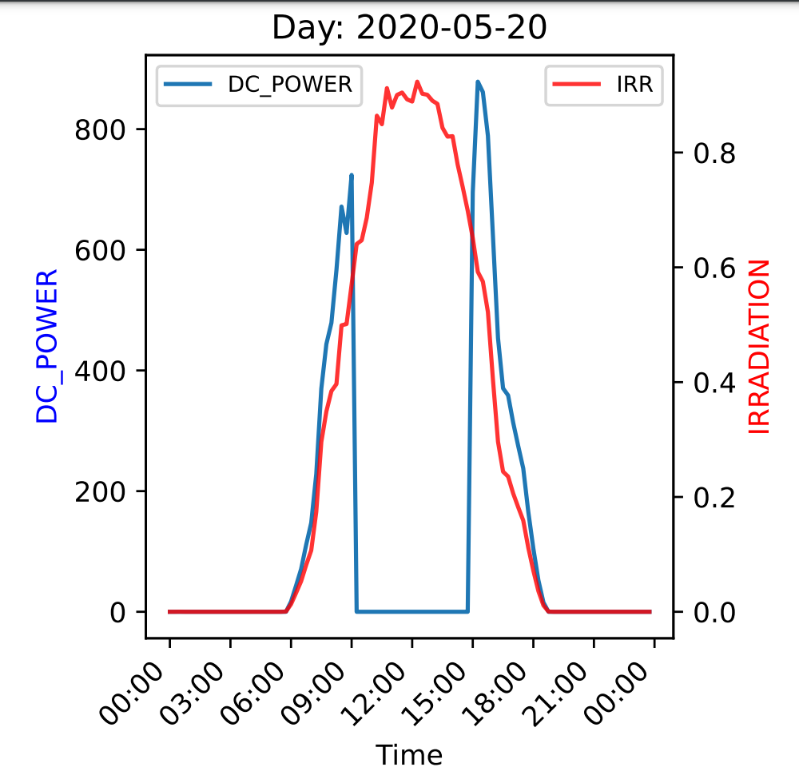
Classifying faulty equipment
Challenge:
No labels for equipment health
Normal
Faulty

Slide 12
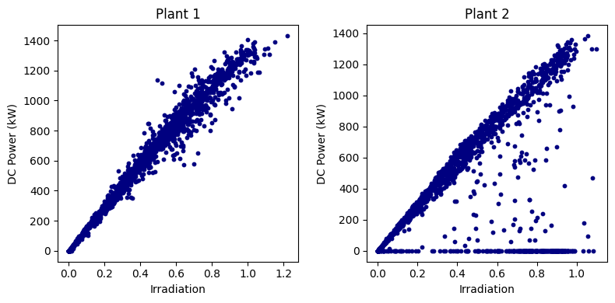
Visualizing the problem
?

Slide 13
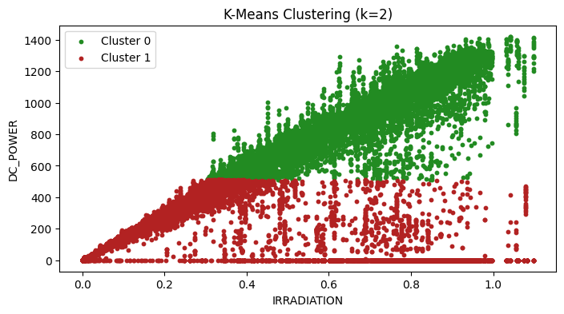
Unsupervised learning
Notes:
K-means (k=2) and the DC power and Irradiation is used to cluster. The clustering has not been succsessful

Slide 14
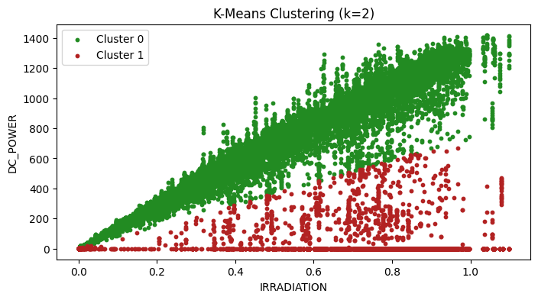

Unsupervised learning
Notes:
Here, instead of features separately, the ratio DC/IRR is used for clustering and here we can see that

Slide 15
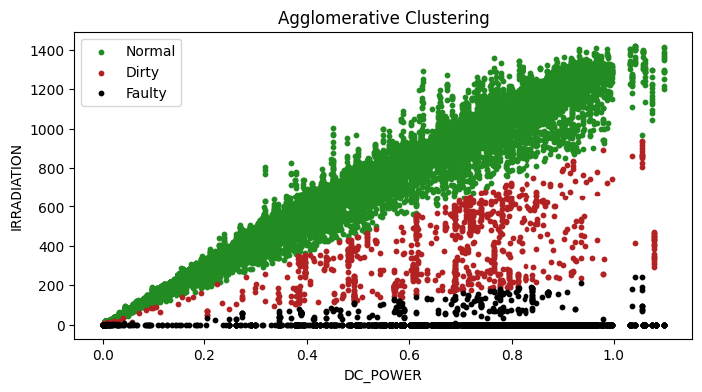

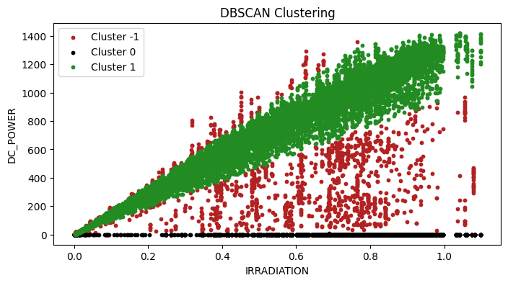
Unsupervised learning
Notes:
K-means is replaced with dbscan and the parameters are adjusted so that we can get three classes.
Cluster -1 : noise
Cluster 0 : normally working inverters
Cluster 1 : faulty inverter

Slide 16
Predicting power output
Gustav
Challenge:
Dataset contains data from faulty equipment
Solution:
Exclude faulty equipment data
Train a more sophisticated model

Slide 17
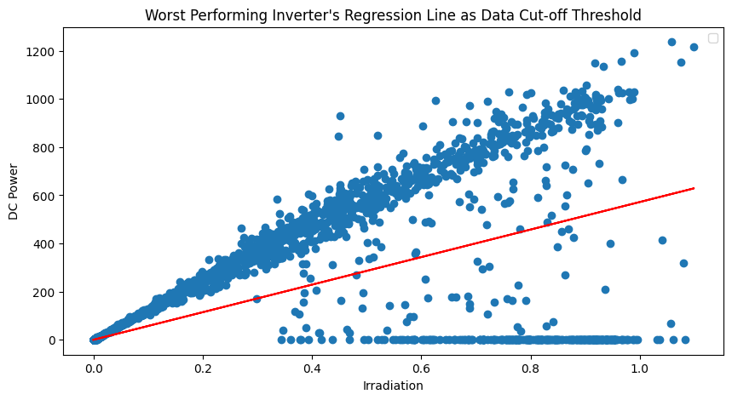
Exclusive approach

Slide 18
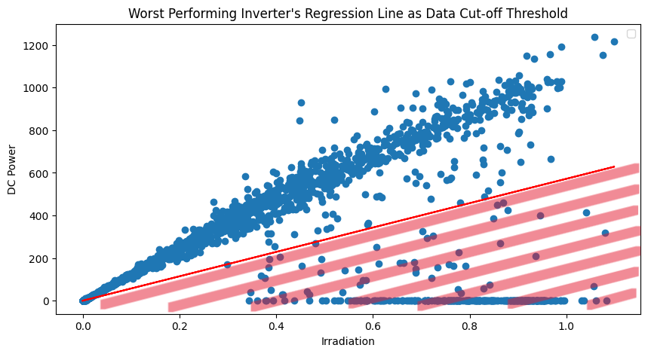
Exclusive approach

Slide 19
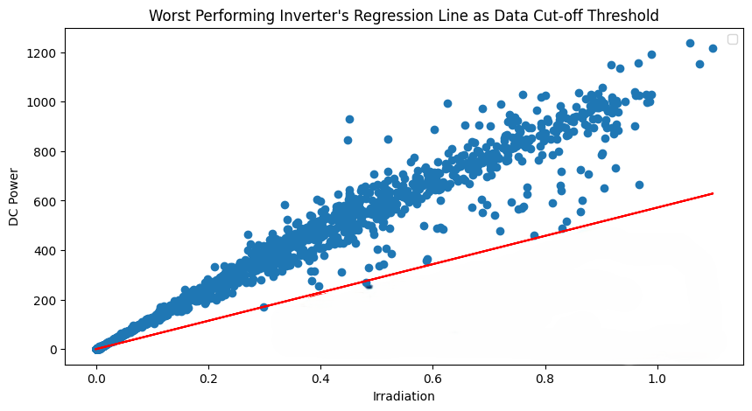
Exclusive approach

Slide 20
Exclusive approach

Slide 21
Inclusive approach
Equipment health labels from classification task
LSTM
Temporal dimension

Slide 22
Inclusive approach
Sunny day

Slide 23
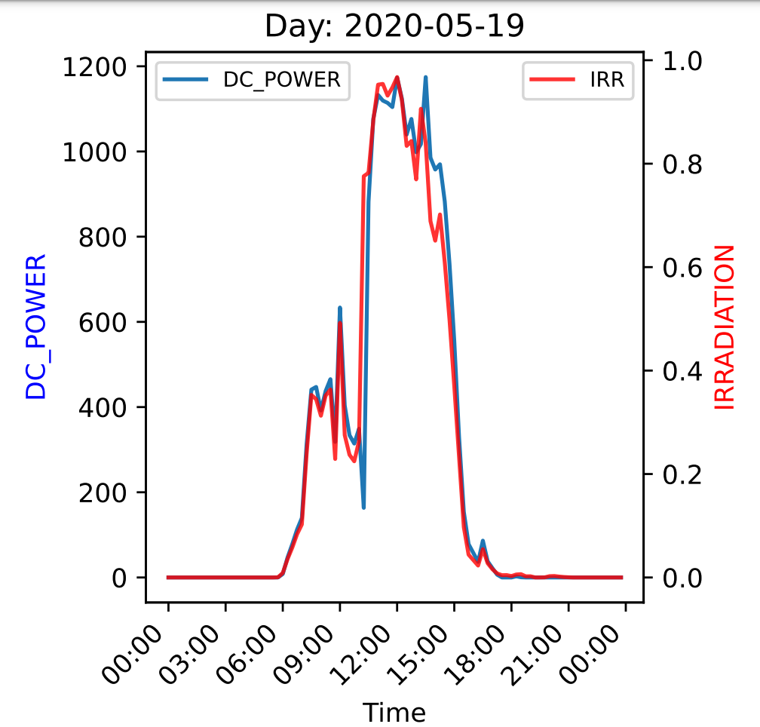
Inclusive approach
Cloudy day

Slide 24

Inclusive approach
Faulty equipment

Slide 25
Thank you
for your
attention!

Slide 26
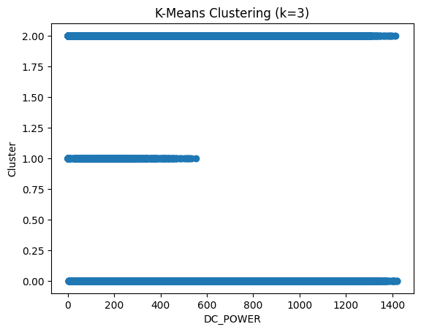
Unsupervised learning

